Slide 1
Acquire Project Team Tools & Techniques
APT T&T
Pre-Assignment
Negotiation
Acquisition
Virtual Teams
Multi-Criteria Decision Analysis

Slide 2
Pre-Assignment Tools & Techniques
When project team members are selected in advance, they are considered pre-assigned.
The situation can occur if;
The project is the result of specific people being identified as part of a competitive proposal.
If the project is dependent upon the expertise of particular persons.
If some staff assignments are defined within the project charter.

Slide 3
Negotiation Tools & Techniques
Staff assignments are negotiated on many projects. The project management team may need to negotiate with;
To ensure that the project receives appropriately competent staff in the required time frame
Project team members will be able, willing and authorized to work on the project until their responsibilities are completed.
Functional Managers
Other project management teams within the performing organization, to appropriately assign scarce or specialized human resources
Other Project Management Teams
For appropriate, scarce, specialized, qualified, certified or other such specified human resources.
Special considerations should be given to external negotiating policies, practices, processes, guidelines, legal and other such criteria
External Organizations

Slide 4
Negotiation Tools & Techniques
The project management’s team ability to influence others plays an important role in negotiating staff assignments, as do the politics of the organization involved.
As an example, a functional manager will weigh the benefits and visibility of competing projects when determining where to assign exceptional performers requested by various project teams.

Slide 5
Negotiation Tools & Techniques
Negotiation process involves in dealing with another person or party to settle a matter.
In successful negotiation, everyone wins
Objective should be agreement not victory
Settlement of issue for benefit of all parties
Two essential things for negotiation. Influence & Confidence
Negotiation Process (3Fs)
Fair, Fast and Firm

Slide 6
Negotiation Tools & Techniques
During Negotiation;
Be firm yet polite when making a stand.
Emphasize advantages & disadvantages of your approach.
Put ego aside and concentrate on the matter at hand.
Aim for solutions that are interest based and not based only on what any individual desires.
Value time, schedules and deadlines. Try not to waste time, but be sensitive to the other party’s needs to discuss.

Slide 7
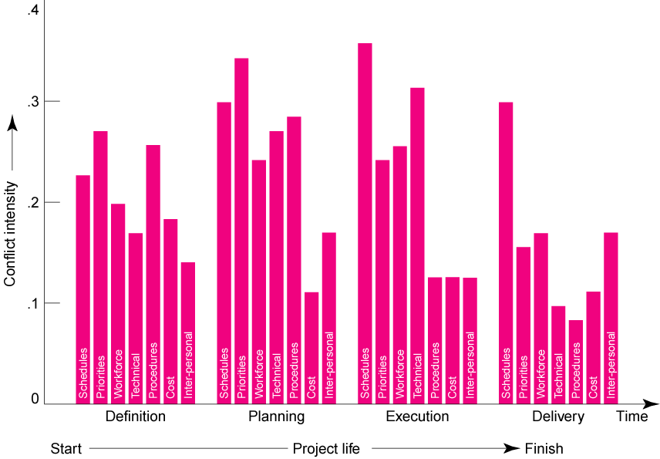
Negotiation Tools & Techniques

Slide 8
Acquisition Tools & Techniques
When the performing organization is unable to provide the staff needed to complete a project, the required services may be acquired from outside sources.
Hiring Individual Consultants
Subcontracting work to other organization
Outsourcing
Near-sourcing
Back-sourcing

Slide 9
Acquisition Tools & Techniques
Outsourcing Advantages
Cost Reduction
Faster Project Completion
High Level of Expertise
Flexibility

Slide 10
Acquisition Tools & Techniques
Outsourcing Disadvantages
Coordination Breakdowns
Loss of Control
Conflict
Security Issues

Slide 11
Virtual Teams Tools & Techniques
A new possibility of acquiring project team members
Disadvantages;
Possibility of misunderstandings.
Feeling of isolation.
Difficulties in sharing knowledge and experience between team members.
Appropriate technology.
Importance of communication planning.
Additional time for conflict resolution, decision making, cultural differences, sharing of success credit.
Advantages;
Teams from widespread geographical areas.
Addition of special expertise.
Different shifts, days, hours.
Mobility limitations and disabilities.
Overcome project constraints of travel expense.

Slide 12
Virtual Teams Tools & Techniques
Challenges:
  Developing trust
    Exchange of social information.
    Set clear roles for each team member.
  Developing effective patterns of communication.
    Include face-to-face if at all possible.
    Keep team members informed on how the overall project is going.
    Don’t let team members vanish.
    Establish a code of conduct to avoid delays.
    Establish clear norms and protocols for surfacing assumptions and conflicts.

Slide 13
Multi-Criteria Decision Analysis Tools & Techniques
Criteria are developed and used to rate or score potential team members
The criteria are weighed according to the relative importance of the needs within the team
Availability
Cost
Experience
Ability
Knowledge
Skills
Attitude
International Factors

Slide 14
Acquire Project Team Outputs
Outputs
Project Staff Assignments
Resource Calendars
Project Management Plan Updates

Slide 15
Project Staff Assignments Outputs
The project is staffed when appropriate people have been assigned to the team
The documentation of these assignments can include;
Project team directory.
Memos to team members.
Names inserted into other parts of the project management plan such as project organization charts and schedules.

Slide 16
Resource Calendars Outputs
It documents the time periods that each project team member is available to work on the project.
Creating a reliable schedule depends on having good understanding of each person’s availability and schedule constraints including;
- Time zones
- Working hours
- Vacation Time
- Local Holidays
- Commitments to other projects

Slide 17
Project Management Plan Updates Outputs
Elements of the project management plan that may be updated include, but are not limited to, the human resource management plan.
For example, the person assigned to a predefined role may not fulfill all staffing requirements outlined in the human resource management plan. When gaps occur, the project management plan needs to be updated to change the team structure, roles or responsibilities.

Slide 18
Lecture 6
Develop Project Team

Slide 19
Objectives of Developing a Project Team
Improving knowledge and skills of team members
Improving feelings of trust and agreement among team members to raise morale, lower conflict and increase team work.
Creating a dynamic, cohesive and collaborative culture to;
1) Improve individual and team productivity, team spirit, and cooperation and
2) Allow cross training and mentoring between
team members to share knowledge and
expertise.

Slide 20
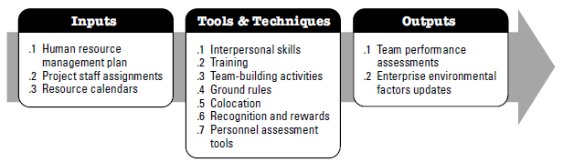
Develop Project Team
Develop Project Team is a process of improving competencies. Team member interaction and overall team environment to enhance project performance.

Slide 21
BENEFITS
Improved Team Work
People skills and competencies
Motivated Employees
Reduced Staff Turnover Rates
Improved overall project performance

Slide 22
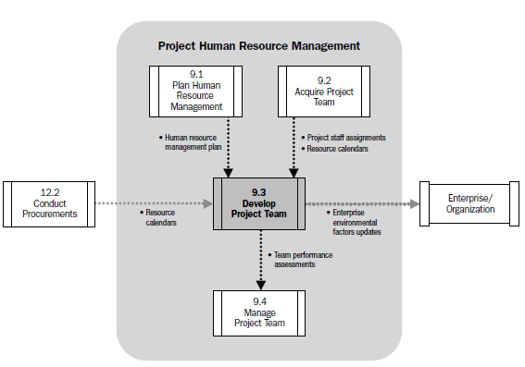
Develop Project Team
Data Flow Diagram

Slide 23
Critical Factors
Environment that facilitates Team Work
Motivation with Challenges and Opportunities
Timely Feedback and Support
Recognizing and Rewarding Good Performance

Slide 24
Factors for High Team Performance
Open & Effective Communication
Creating Team Building Opportunities
Reducing Trust Deficit
Constructive Conflict Management
Encourage Collaborative Problem Solving and Decision Making
TEAM PERFORMANCE

Slide 25
Objectives Of Developing A Project Team
Improving knowledge and skills of team members
  In order to complete project deliverables, while reducing costs, reducing schedules, and improving quality
Enhancing trust and agreement between team members, in order to
  Raise morale
  Reduce conflict
  Increase teamwork
Creating a dynamic, cohesive, and collaborative team culture, in order to
  Improve individual and team productivity, team spirit and cooperation, and
  Allow cross training, to share knowledge and expertise

Slide 26
Develop Project Team Inputs
Human Resource Management Plan
Resource Calendars
Project Staff Assignments

Slide 27
Human Resource Management Plans Inputs
How Project Human Resource should be;
Identification of training strategies and plans to develop project team.
Identified
Staffed
Managed
Released
REWARDS
FEEDBACK
ADDITIONAL TRAINING
DISCIPLINARY ACTIONS

Slide 28
Project Staff Assignments Inputs
WHO IS WHO IN THE TEAM
The project is staffed when appropriate people have been assigned to the team
The documentation of these assignments can include;
Project team directory.
Memos to team members.
Names inserted into other parts of the project management plan such as project organization charts and schedules.

Slide 29
Resource Calendars Inputs
It documents the time periods that each project team member is available to work on the project.
Creating a reliable schedule depends on having good understanding of each person’s availability and schedule constraints including;
- Time zones
- Working hours
- Vacation Time
- Local Holidays
- Commitments to other projects

Slide 30
Develop Project Team Tools & Techniques
DPT T&T
Interpersonal Skills
Training
Team Building Activities
Ground Rules
Colocation
Recognition & Rewards
Personnel Assessment Tools

Slide 31
Interpersonal Skills Tools & Techniques
Communication Skills
Emotional Intelligence
Negotiation
Conflict Resolution
Influence
Team Building
Group Facilitation
SOFT SKILLS

Slide 32
Training Tools & Techniques
What will you be doing?
  1. Conduct a needs assessment and analysis.
  2. Design a training program.
  3. Develop a training program.
  4. Recommend implementation and delivery of training.
  5. Evaluate the training.

Slide 33
Team Building Activities Tools & Techniques
Team building activities can vary from a 5 minute agenda item in a status review meeting to an offsite professionally facilitated experience designed to improve interpersonal relationships.
The objective of team-building activities is to help individual team members work together effectively.
These strategies are particularly valuable when team members operate from remote locations without the benefit of face-to-face contact.
Informal communication and activities can help in building trust and establishing good working relationships.

Slide 34
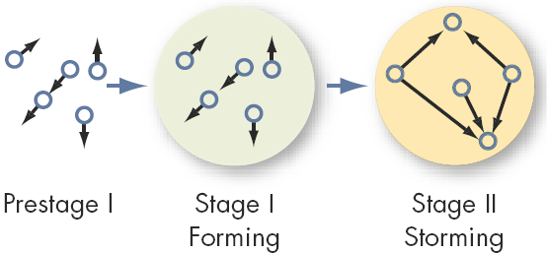
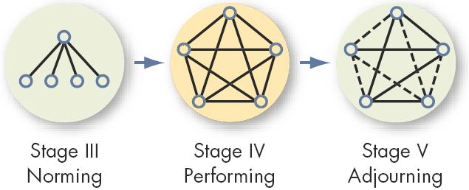
Team Building Activities Tools & Techniques
THE FIVE STAGE TEAM DEVELOPMENT MODEL

Slide 35
Ground Rules Tools & Techniques
Clear expectations regarding acceptable behavior by project team members.
Early commitment to clear guidelines decreases misunderstandings and increases productivity.
Discussing ground rules in areas such as;
Code of conduct
Communication
Working Together
Meeting Etiquette
Shared Responsibility

Slide 36
Establishing Ground Rules Tools & Techniques
Establishing operational ground rules for how the team will work together.
Consists of not only organizational and procedural issues but also how the team will interact with each other.

Slide 37
Colocation Tools & Techniques
Placing many or all of the most active project team members in the same physical location to enhance their ability to perform as a team
Temporary
Permanent
War Room
While Colocation is considered as a good strategy, the use of virtual teams can bring benefits such as proximity of team members to suppliers, customers, or other key stakeholders.

Slide 38
Recognition & Rewards Tools & Techniques
The original plans concerning ways in which to reward people are developed during the ‘Plan Human Resource Management Process’.
Pertinent Aspects
Satisfaction of need which is valued by that individual.
Take care of Cultural Differences.
Tangible & Intangible Rewards.
Team Recognition throughout the Life Cycle
Function of Project Performance Appraisals.

Slide 39
Managing Project Reward System Tools & Techniques
Recognizing individual members regardless of their accomplishments can distract from team unity.
Group Rewards
  Who gets what reward?
  How to make the reward have lasting significance?
  How to recognize individual performance?
    Letters of commendation
    Public recognition for outstanding work
    Desirable job assignments
    Increased personal flexibility

Slide 40
Personnel Assessment Tools Tools & Techniques
These tools give the Project Manager and the project team insight into areas of strength and weakness.
These tools help project managers assess the team preferences, aspirations, how they process and organize information, how they tend to make decisions, and how they prefer to interact with people.
Attitudinal Surveys
Specific Assessments
Structured Interviews
Ability Tests
Focus Groups

Slide 41
Who Performs the Appraisal?
Immediate Supervisor
Higher Management
Self-Appraisals
Peers (Co-Workers)
Evaluation Teams
Customers
“360° Appraisals”

Slide 42
APPRAISAL TYPES
Management by Objectives. MBO evaluates how well an employee has accomplished objectives determined to be critical in job performance. This method aligns objectives with quantitative measures such as sales, profits, zero-defect , units produced.
360 Degree Performance Multi-source Feedback which involves evaluation by all the members of the organization that are in connection with the person in question including himself, his peers, sub-ordinates, supervisors and even the external customers. It usually starts off with self-evaluation but afterwards all relevant supervisors, peers and sub-ordinates evaluate the person in question. This is a modern tool in performance evaluation.
Peer Appraisal Performance appraisal done by one’s fellow employees
Team Performance Appraisal based on TQM concepts, that recognizes team accomplishment rather than individual performance

Slide 43
The 360º Appraisal Interview
Supervisor
Other Superiors
Other Superiors
Individual Staff
Self-Assessment
Peers
Customers
Teams
Teams
Sub-Ordinates

Slide 44
Employee Performance Evaluations
Everyone is entitled to be stupid, but some abuse the privilege.
Since my last report, he has reached rock bottom and has started to dig.
His men would follow him anywhere, but only out of curiosity.
I would not allow this employee to breed.
Works well when under constant supervision and cornered in a trap.
When he opens his mouth, it seems that this is only to change whichever foot was previously in there.
He is in the habits of pushing doors marked pull.
This employee should go far --- and the sooner he starts, the better.
If brains were taxed, he'd get a rebate.

Slide 45
Develop Project Team Outputs
DPT Outputs
Team Performance Assessments
Enterprise Environmental Factors Updates

Slide 46
Team Performance Assessments Outputs
Formal and Informal assessments of Project Team’s Effectiveness
Should be determined by all parties
Technical Success
Agreed upon Project Objectives
Meeting Quality Levels
Performance on Project Schedule
Performance on Budget

Slide 47
Team Performance Assessments Outputs
Improvements in skills that allow individuals to perform assignments more effectively.
Improvements in competencies that help the team perform better as a team.
Reduced turnover Rate
Increased team cohesiveness where team members share information and experiences openly and help each other to improve the overall project performance.
Specific Training
Coaching
Mentoring
Assistance
Required Resources

Slide 48
Enterprise Environmental Factors Updates Outputs
The enterprise environmental factors that may be updated as a result of the ‘Develop Project Team Process’ include but are not limited to;
  Personal Administration.
  Employee Training Records.
  Skill Assessments.

Slide 49
Break!

Slide 50
Case Study

